Slide 1
Ch3. Transport Phenomena

Slide 2
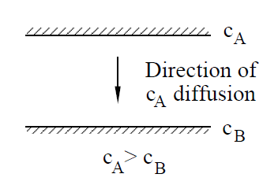
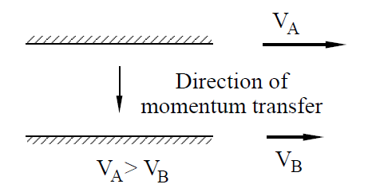
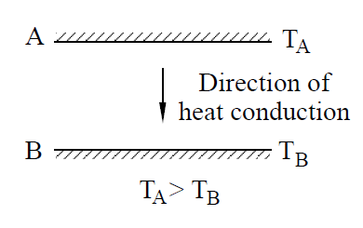
Transport of
Mass, Momentum and Energy

Slide 3
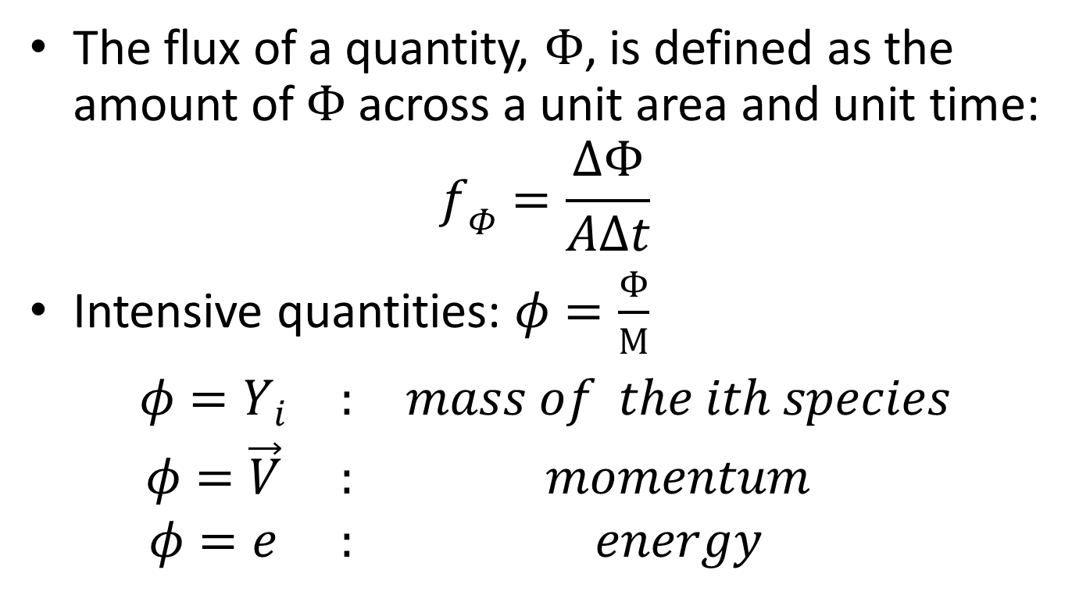
Mass, Momentum, and Energy Flux
The flux of a quantity, $Φ$, is defined as the amount of $Φ$ across a unit area and unit time:
$$f_{Φ}=\frac{ΔΦ}{AΔt}$$
Intensive quantities: $φ=\frac{Φ}{M}$
$$\begin{matrix}φ=Y_{i} & : & mass of the ith species \\ φ=\vec{V} & : & momentum \\ φ=e & : & energy\end{matrix}$$

Slide 4
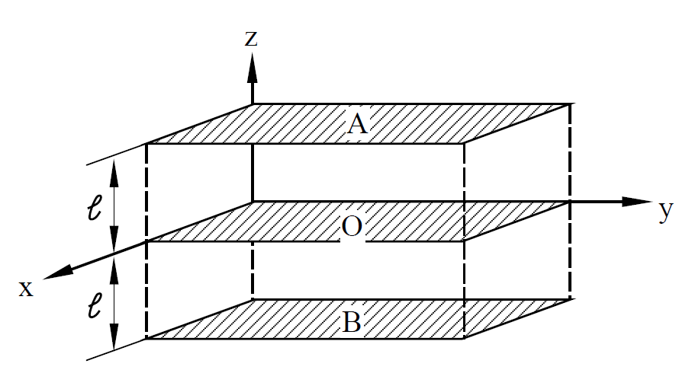
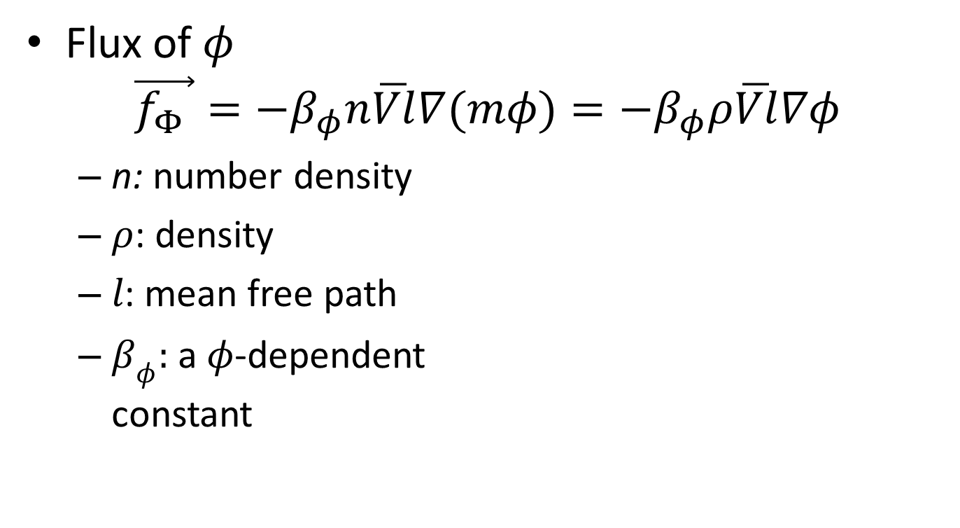
Transport Coefficients and
Molecular Collisions
Flux of $φ$
$$\vec{f_{Φ} }={−β}_{φ}n\overline{Vl}∇(mφ)={−β}_{φ}ρ\overline{Vl}∇φ$$
  n: number density
  $ρ$: density
  $l$: mean free path
  $β_{φ}:$ a $φ$-dependent
  constant

Slide 5
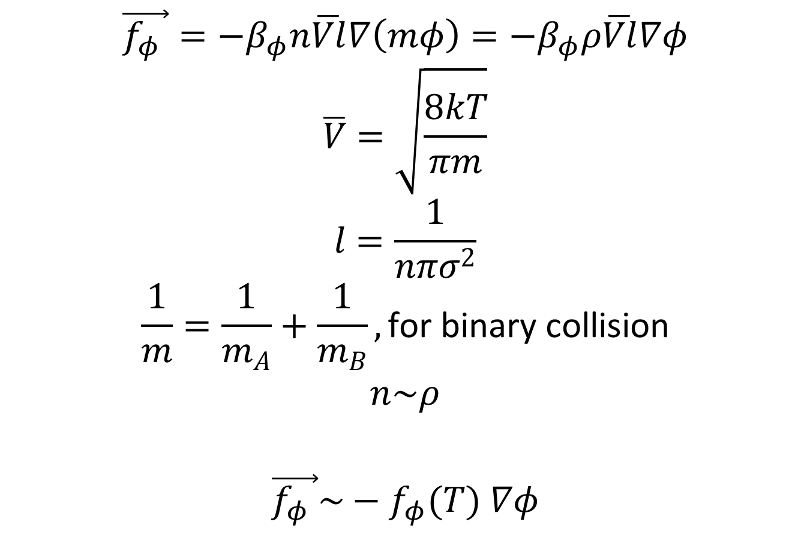
$$\vec{f_{φ} }={−β}_{φ}n\overline{Vl}∇\left(mφ\right)={−β}_{φ}ρ\overline{Vl}∇φ$$
$$\overline{V}=\sqrt{\frac{8kT}{πm}}$$
$$l=\frac{1}{nπσ^{2}}$$
$$\frac{1}{m}=\frac{1}{m_{A}}+\frac{1}{m_{B}}, \text{for} \text{binary} \text{collision}$$
$$n\sim ρ$$
$$\vec{f_{φ} }\sim −f_{φ}(T) ∇φ$$

Slide 6
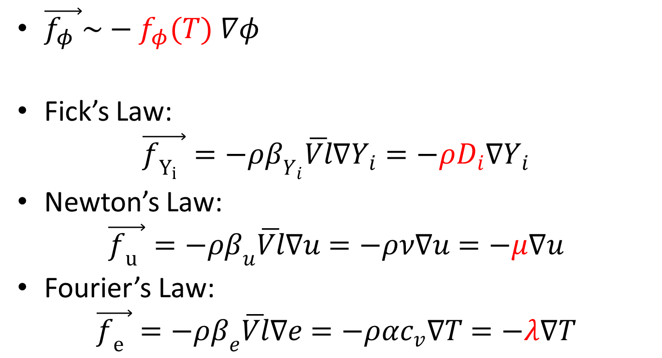
Transport Laws
$\vec{f_{φ} }\sim −f_{φ}(T) ∇φ$
Fick’s Law:
$$\vec{f_{Y_{i}} }=−ρβ_{Y_{i}}\overline{Vl}∇Y_{i}=−ρD_{i}∇Y_{i}$$
Newton’s Law:
$$\vec{f_{u} }=−ρβ_{u}\overline{Vl}∇u=−ρν∇u=−μ∇u$$
Fourier’s Law:
$$\vec{f_{e} }=−ρβ_{e}\overline{Vl}∇e=−ραc_{v}∇T=−λ∇T$$

Slide 7
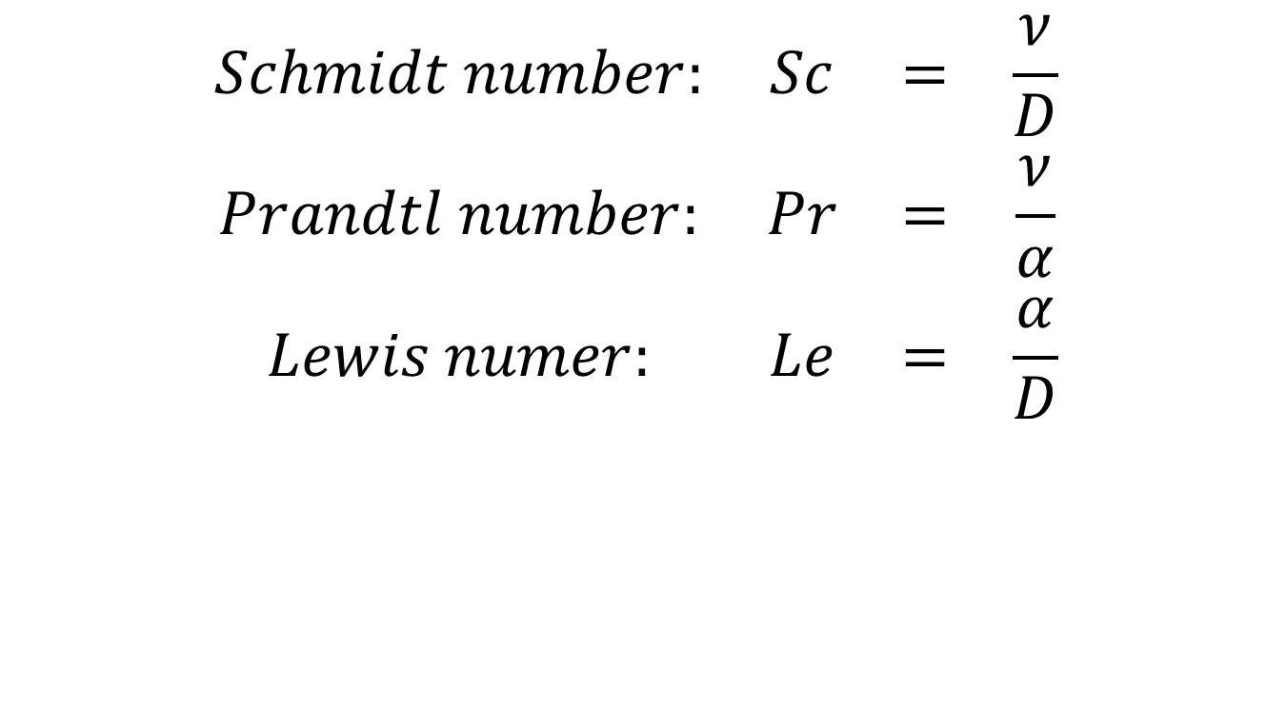
Dimensionless Numbers
$$\begin{matrix}Schmidt number: & Sc & = & \frac{ν}{D} \\ Prandtl number: & Pr & = & \frac{ν}{α} \\ Lewis numer: & Le & = & \frac{α}{D}\end{matrix}$$

Slide 8
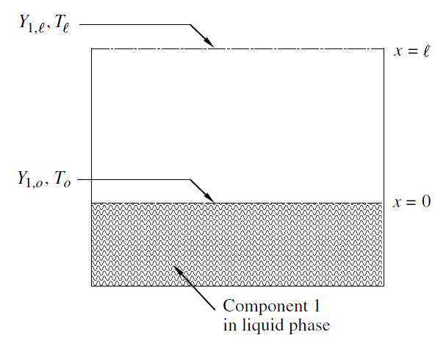
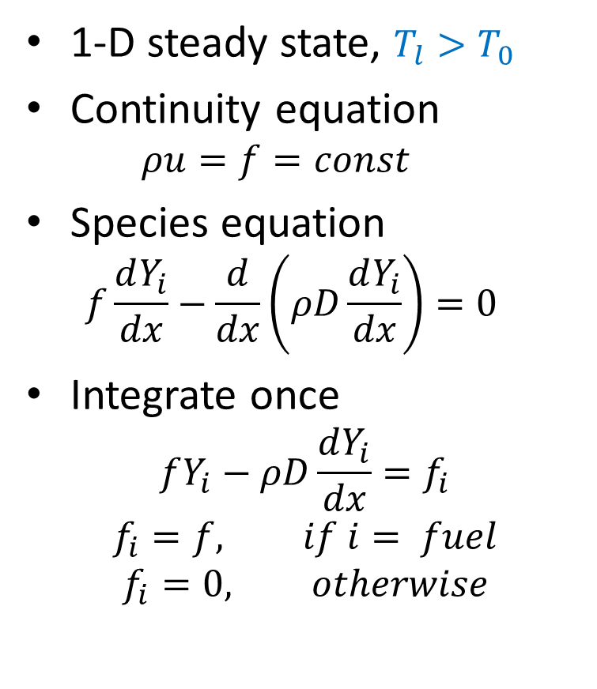
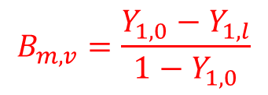
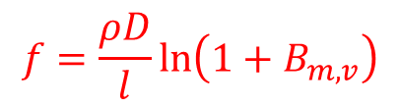
Fuel Vaporization and Stefan Flow (1/2)
1-D steady state, $T_{l}{>T}_{0}$
Continuity equation
  $$ρu=f=const$$
Species equation
  $$f\frac{dY_{i}}{dx}−\frac{d}{dx}\left(ρD\frac{dY_{i}}{dx}\right)=0$$
Integrate once
  $$fY_{i}−ρD\frac{dY_{i}}{dx}=f_{i}$$
  $$f_{i}=f, if i= fuel$$
  $$f_{i}=0, otherwise$$
$$f=\frac{ρD}{l}\ln\left(1+B_{m,v}\right)$$
$$B_{m,v}=\frac{Y_{1,0}−Y_{1,l}}{1−Y_{1,0}}$$

Slide 9
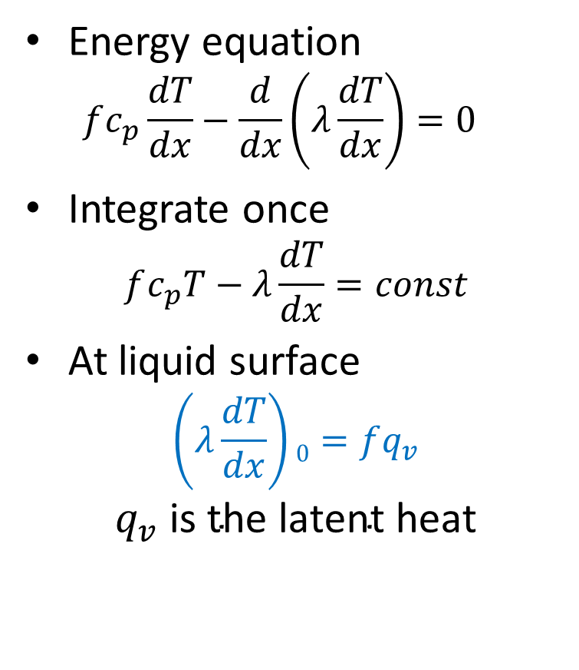
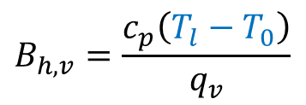
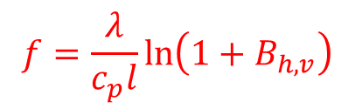
Fuel Vaporization and Stefan Flow (2/2)
Energy equation
  $$fc_{p}\frac{dT}{dx}−\frac{d}{dx}\left(λ\frac{dT}{dx}\right)=0$$
Integrate once
$$fc_{p}T−λ\frac{dT}{dx}=const$$
At liquid surface
$$\left(λ\frac{dT}{dx}\right)0=fq_{v}$$
$$q_{v} \text{is} \text{the} \text{latent} \text{heat}$$
$$f=\frac{λ}{c_{p}l}\ln\left(1+B_{h,v}\right)$$
$$B_{h,v}=\frac{c_{p}\left(T_{l}−T_{0}\right)}{q_{v}}$$

Slide 10
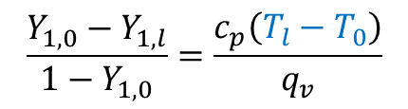
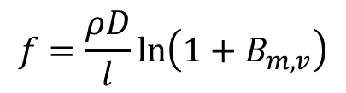

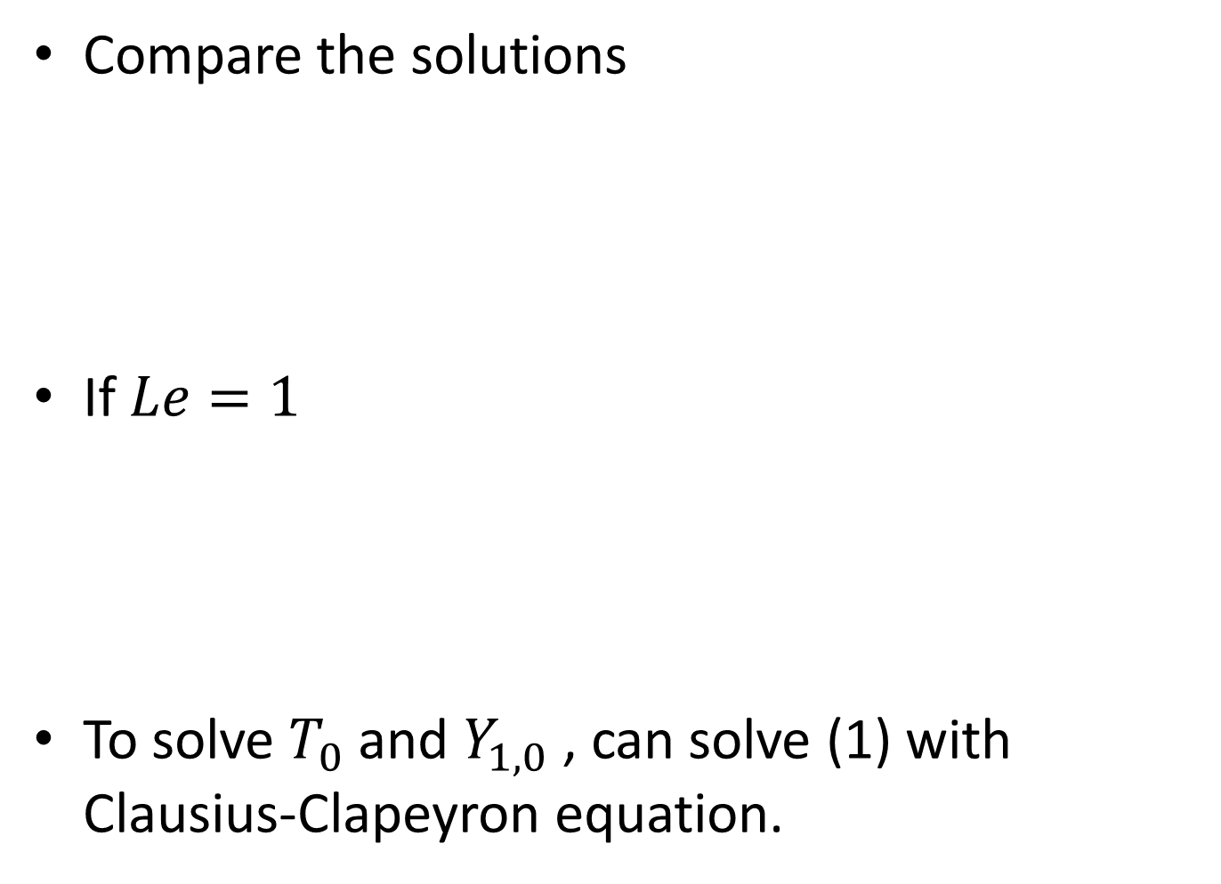
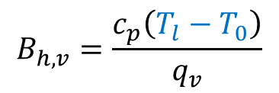
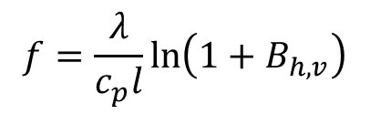
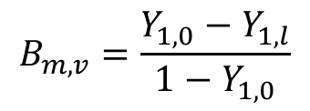
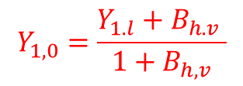
Compare the solutions
If $Le=1$
To solve $T_{0}$ and $Y_{1,0}$ , can solve (1) with Clausius-Clapeyron equation.
$$f=\frac{ρD}{l}\ln\left(1+B_{m,v}\right)$$
$$f=\frac{λ}{c_{p}l}\ln\left(1+B_{h,v}\right)$$
$$B_{m,v}=\frac{Y_{1,0}−Y_{1,l}}{1−Y_{1,0}}$$
$$B_{h,v}=\frac{c_{p}\left(T_{l}−T_{0}\right)}{q_{v}}$$
$$B_{m,v}=B_{h,v}$$
$$\frac{Y_{1,0}−Y_{1,l}}{1−Y_{1,0}}=\frac{c_{p}\left(T_{l}−T_{0}\right)}{q_{v}}$$
$$Y_{1,0}=\frac{Y_{1.l}+B_{h.v} }{{1+B}_{h,v}}$$
(1)

Slide 11
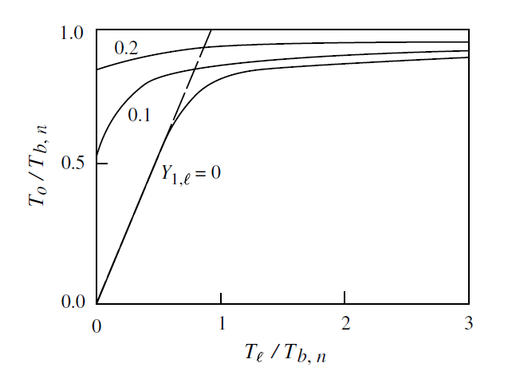
The Wet-Bulb Temperature, T₀
water

Slide 12
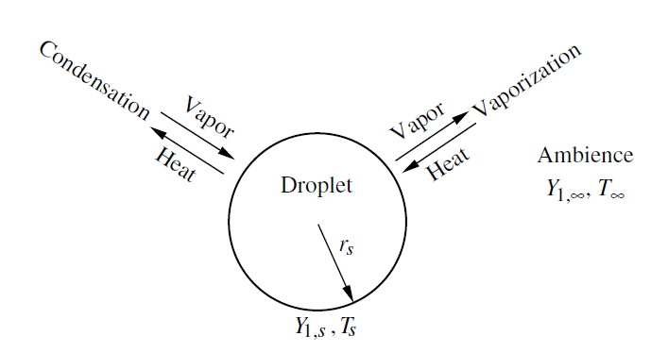
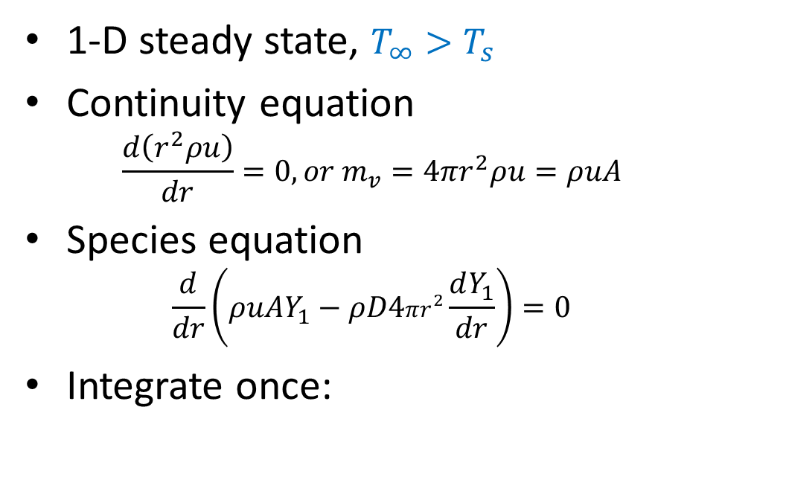


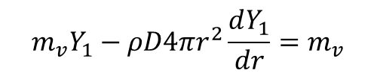
Droplet Vaporization (1/2)
1-D steady state, $T_{∞}{>T}_{s}$
Continuity equation
  $$\frac{d\left(r^{2}ρu\right)}{dr}=0, or{ m}_{v}=4πr^{2}ρu=ρuA$$
Species equation
  $$\frac{d}{dr}\left(ρuAY_{1}−ρD4πr^{2}\frac{dY_{1}}{dr}\right)=0$$
Integrate once:
$$m_{v}=ρD4πr_{s}\ln\left(1+B_{m,v}\right)$$
$$m_{v}Y_{1}−ρD4πr^{2}\frac{dY_{1}}{dr}=m_{v}$$
$$B_{m,v}=\frac{Y_{1,s}−Y_{1,∞}}{1−Y_{1,s}}$$

Slide 13

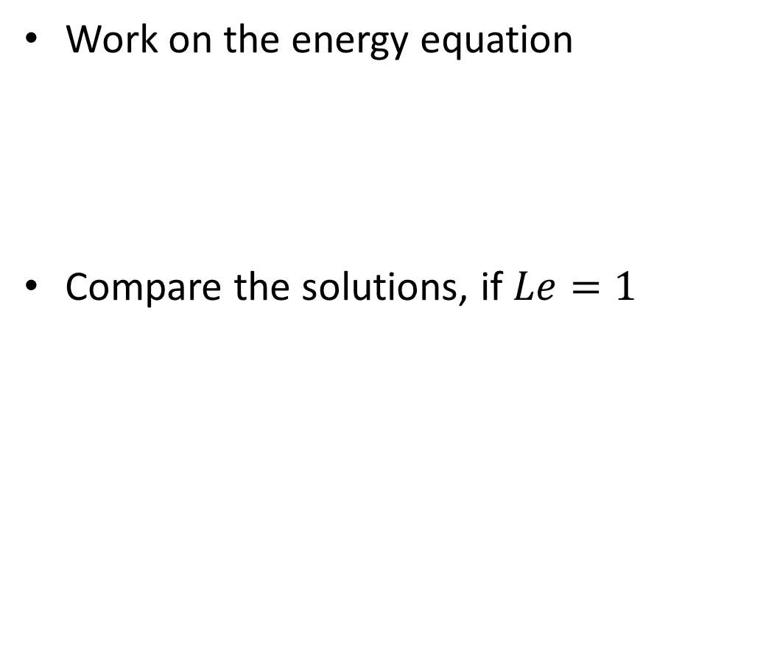
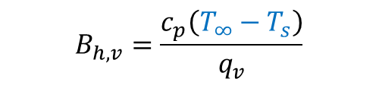
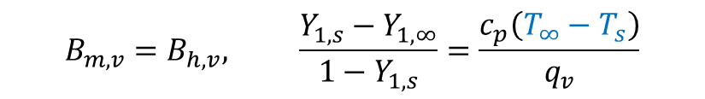
Droplet Vaporization (2/2)
Work on the energy equation
Compare the solutions, if $Le=1$
$$m_{v}=ρα4πr_{s}\ln\left(1+B_{h,v}\right)$$
$$B_{h,v}=\frac{c_{p}\left(T_{∞}−T_{s}\right)}{q_{v}}$$
$$B_{m,v}=B_{h,v}, \frac{Y_{1,s}−Y_{1,∞}}{1−Y_{1,s}}=\frac{c_{p}\left(T_{∞}−T_{s}\right)}{q_{v}}$$

Slide 14
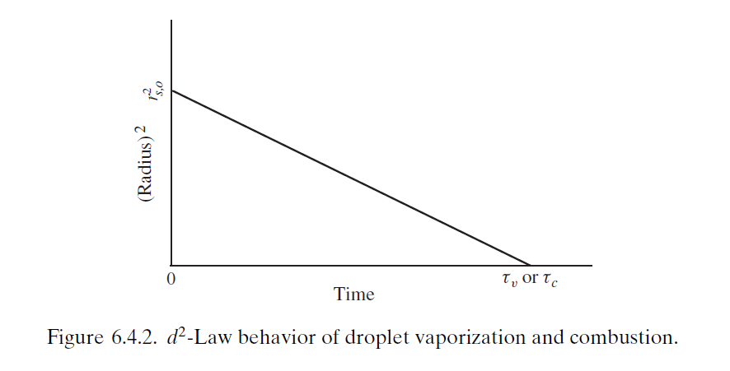
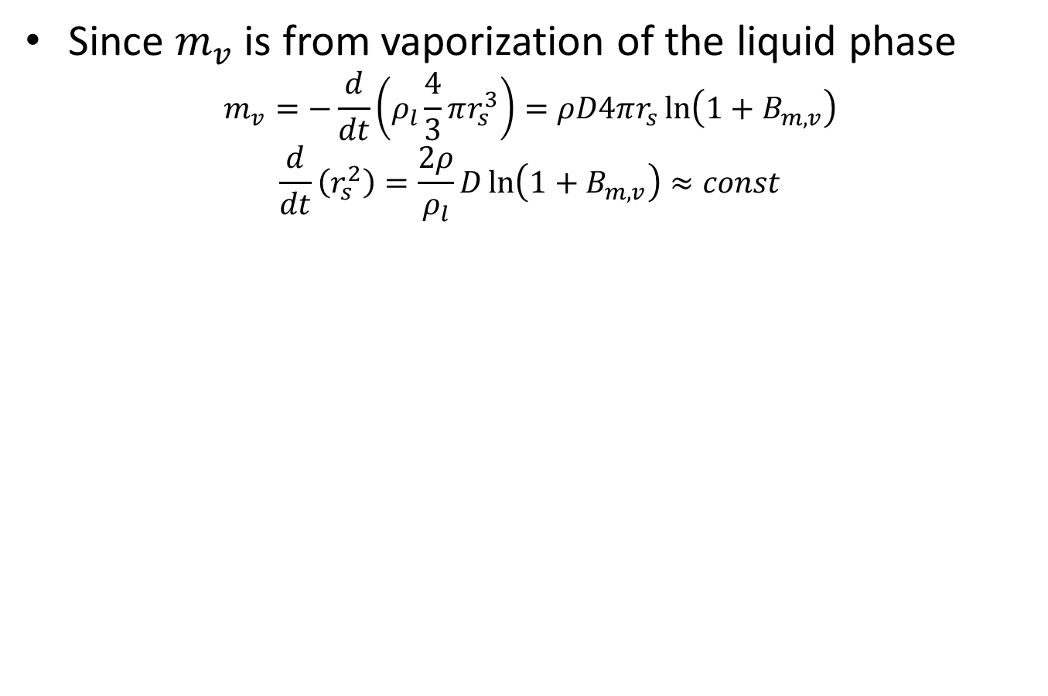
The d²-Law
Since $m_{v}$ is from vaporization of the liquid phase
$$m_{v}=−\frac{d}{dt}\left(ρ_{l}\frac{4}{3}πr_{s}^{3}\right)=ρD4πr_{s}\ln\left(1+B_{m,v}\right)$$
$$\frac{d}{dt}\left(r_{s}^{2}\right)=\frac{2ρ}{ρ_{l}}D\ln\left(1+B_{m,v}\right)≈const$$

